Slide 1

Welcome
AGM 2019

Slide 2
Agenda
Welcome
Chairman’s Report
Connectors
VFU
NCC
Finance
Security Provider
Question Time
Election of Committee
Closure

Slide 3
Chairman’s Report

Slide 4
Committee
John Parker – Chairman
Patrick Wright - Vice Chairman…
Craig Botha – Rapid Response +
Karen MacIntire – Membership, Radio Admin, NCC
Rob Mousley – Communications and Incidents
Erik Meijer– ADT Liaison
  Tessa Oliver - Chapman’s Peak Volunteer Fire Unit
  Sue Montgomery – CPF Liaison
  Lynn Hogan – Community Connectors
  Geoff Young – Treasurer
  Jeanette Beukes – Secretary

Slide 5
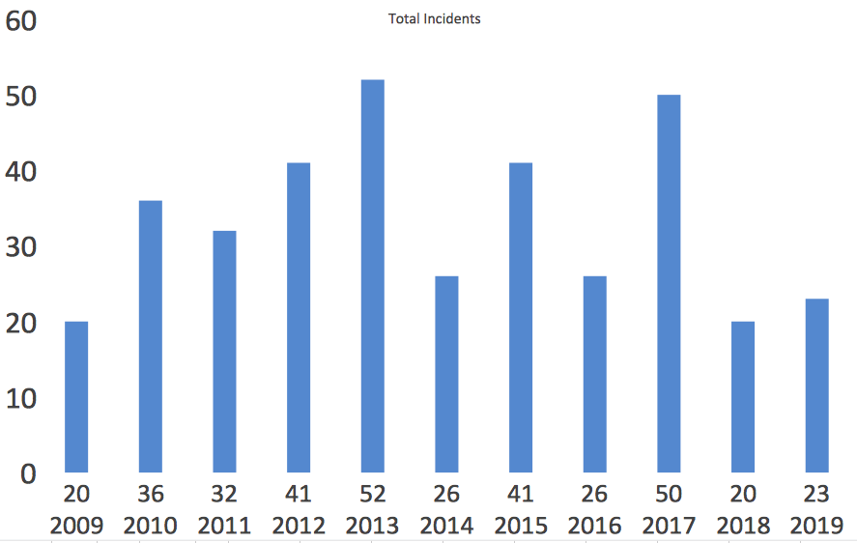
Total Incidents by Year

Slide 6
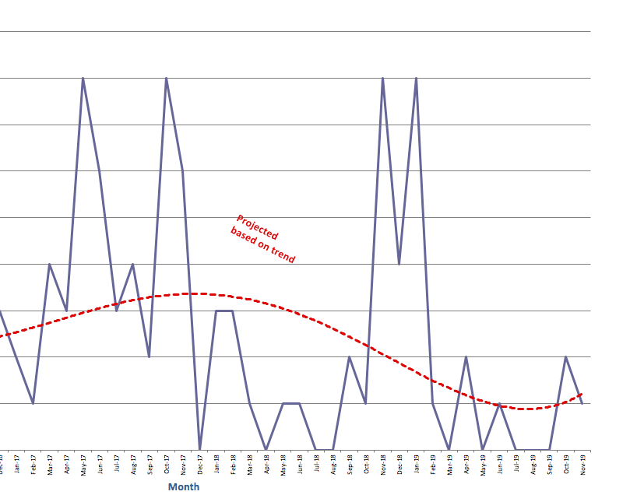
Incidents per month Projected
FSS
2017
2018
2019

Slide 7
Incident list 2019 (part 1)

Slide 8
Incident list 2019 (part 2)

Slide 9
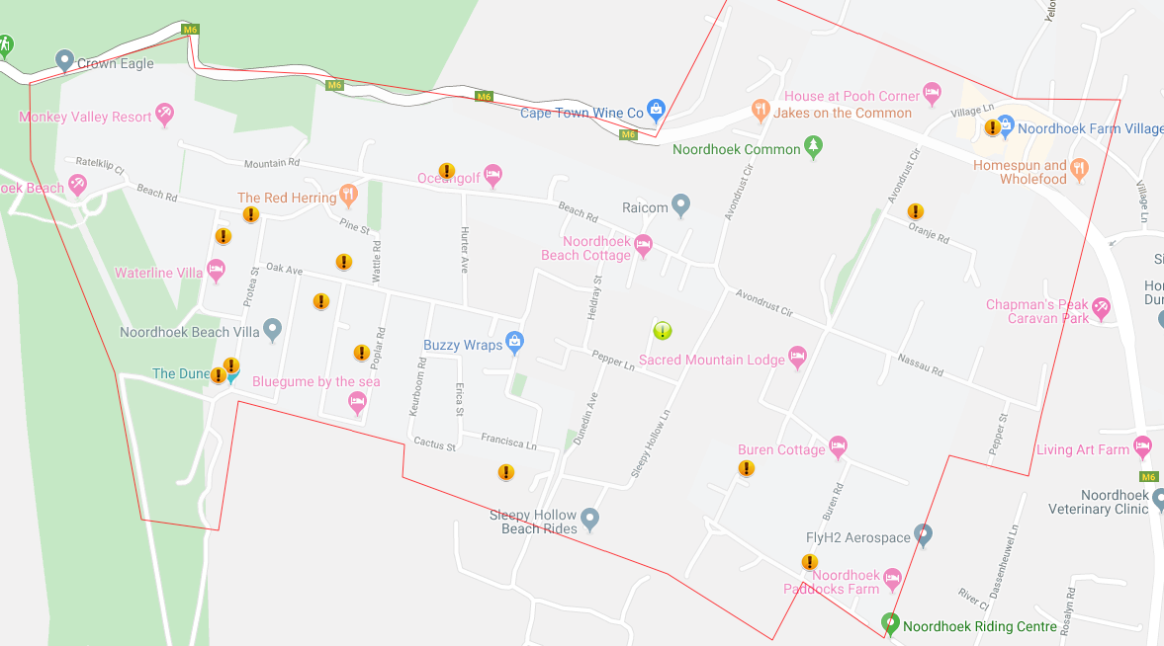
Incident locations 2019

Slide 10
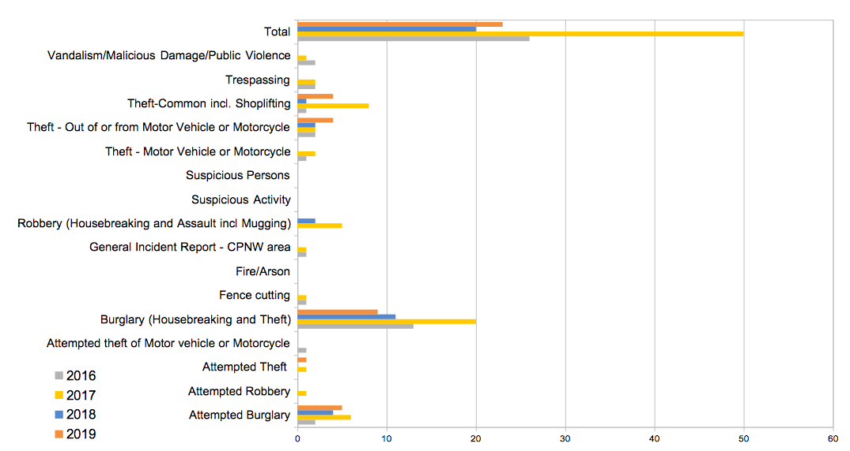
Incidents by Type

Slide 11
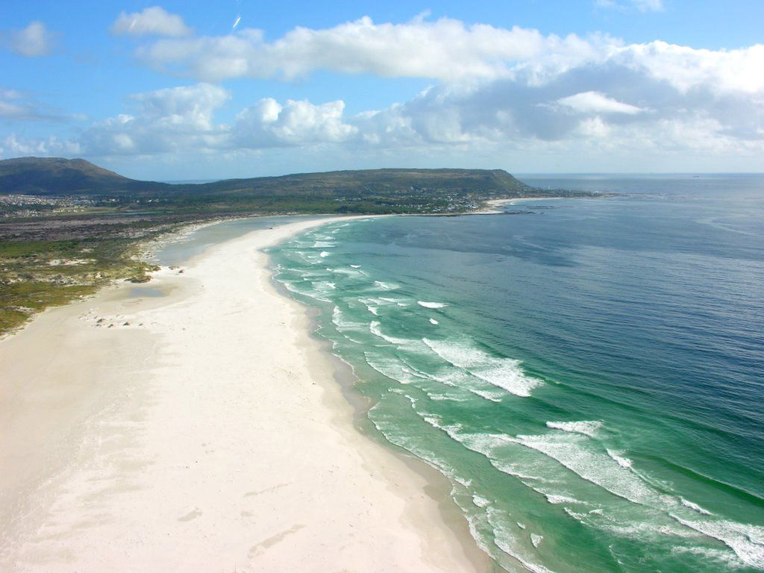
The Beach

Slide 12
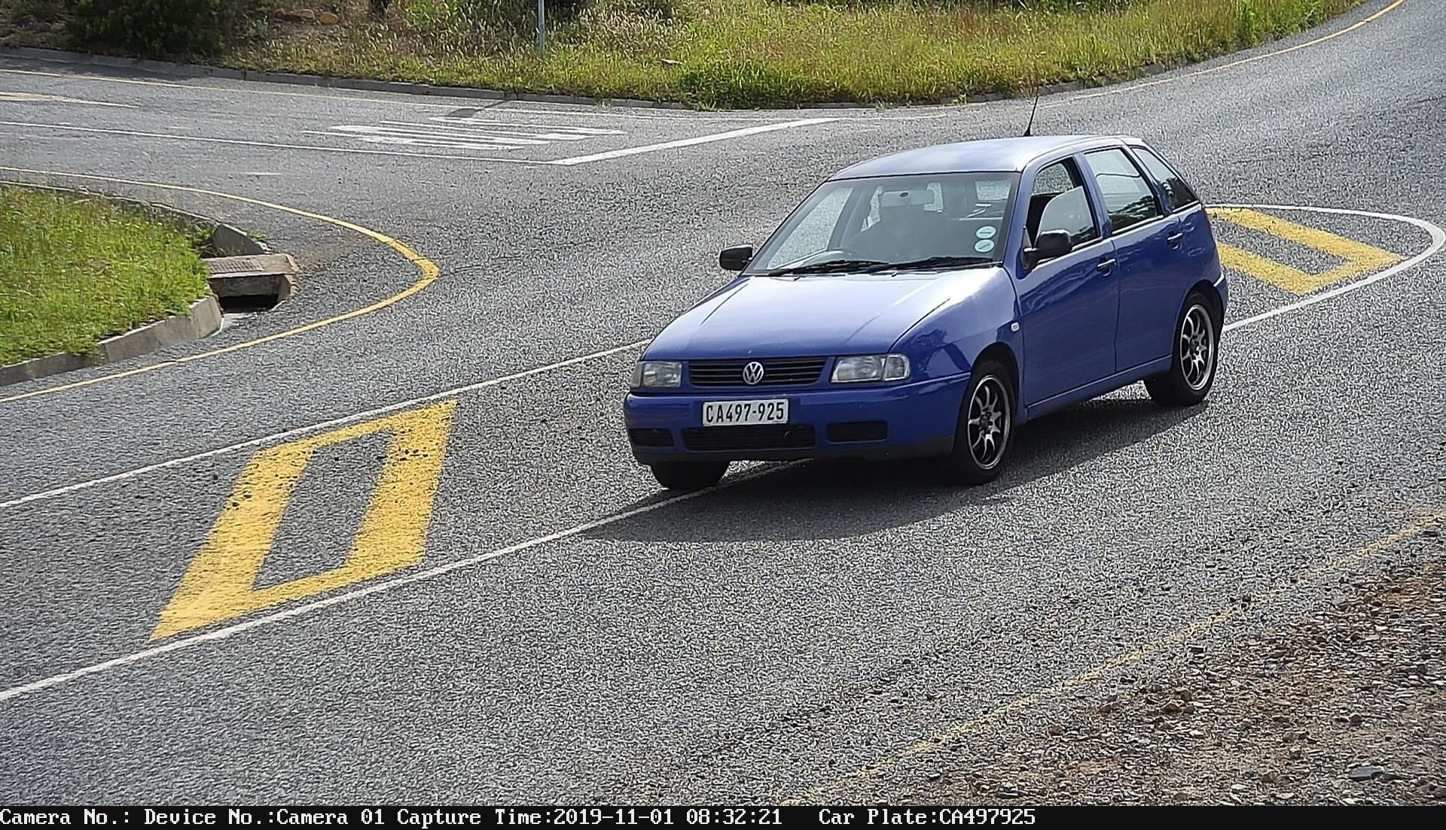
Cameras

Slide 13
ADT

Slide 14
ADT
Monitoring only via telephone line: R196.98 + 4% = R204.86
Monitoring only radio or radio & telephone: R211.46 + 4% = R219.92
Response only: R412.47 + 4% = R428.97
Radio monitoring+ response + CPNW: R653.93 - R30 = R623.93 + 4% = R648.89 + R30 =R678.89
Telephone monitoring+ response + CPNW: R639.45 - R30 = R609.45 +4% = R633.83 + R30 = R663.83
(Plus annual radio licence fees)
When you pay for a whole year in advance for radio, response & CPNW, you will pay 11 * R678.89 = R7,467.79

Slide 15
CPNW Community Connector Groups
What are Community Connector Groups?
We have 24 Connector WhatsApp groups at present.
Ideally we need 40-50 groups so that groups are not too large
Contact Lynne Hogan to join a group or start one
Clusters of Neighbours (between 6-8 households in every cluster)
Community Connectors (one per cluster)
CPRT
ADT
RADIO

Slide 16
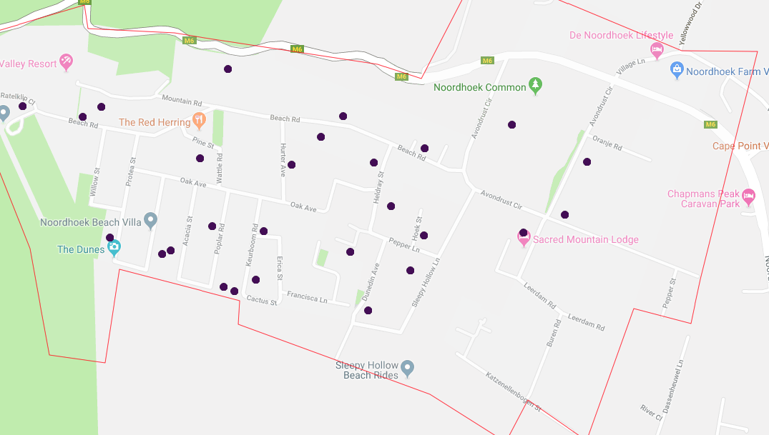
CPNW Community Connector Groups

Slide 17
CPNW Social Media
Mainstay remains Website and emails
Driven primarily by what people use: currently WhatsApp and FB
Policies WRT appropriate use of group; respect for group users; legal considerations; reputation
Ideally we should be able to keep security groups UN-muted!
TIME CONSUMING
Connector (small neighbour groups) less formal, governed by needs of the group, 1 Connector linked to CPNW Committee Member
STOP & THINK: Accurate? Relevant? Concise and Clear?

Slide 18
Chapman's Peak Voluntary Fire Unit
Currently 23 members part of the group
Equipment housed in container behind NCC
Fire drill to take place on 2 Dec
Refresher training to take place in next 3 weeks by Enviro Wildfire Services
Risk reduction measures ito alien clearing taking place on De Goede Hoop property along Chapman's Peak Drive

Slide 19
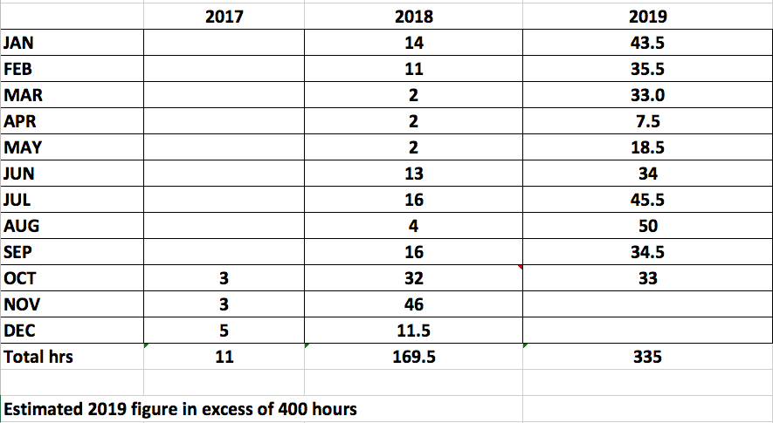
Noordhoek Community Centre
Booking Figures

Slide 20
Noordhoek Community Centre

Slide 21
Noordhoek Community Centre

Slide 22
Noordhoek Community Centre

Slide 23
CPNW Financial Report

Slide 24
Alternative Security Provider
Deep Blue Security – Hout Bay
Currently operating in Hout Bay and Marina da Gama, marketing in limited parts of Hout Bay
Follow a strategy of developing presence in limited areas at one time, with dedicated resources
Emphasis on developing surveillance/intelligence to back this up
Attendance at CPF/Joint Security meetings
Positive references from NW members in Marina da Gama and from a limited number of individual customers
Consultations with neighbouring NW’s

Slide 25
Deep Blue Security –Proposal
One dedicated vehicle 24/7 and additional vehicle 12/7, both with ARO’s
Monitoring of all cameras in the area plus installation of additional cameras in sensitive areas
Monthly fee: R473.50 plus VAT (R71= 544,50), will be reduced to R448.50 plus VAT (R67.28= R515.78) if 300 sign up; plus annual radio licence fee of R299(plus VAT: R44.85=343.85) for 12 months
30% Discount for pensioners
Alarm radio and link over free of charge
Commitment to limiting annual increases to a maximum per the latest 12-month CPI
MOU with CPNW setting out terms of members contracts and collective commitments to CPNW

Slide 26
Deep Blue Security –Proposal Details
ARO’s will be prepared to enter any property if alarm activated
Vehicle monitoring and full details of any incidents provided to CPNW
Collect membership fees for CPNW
Detailed schedule of charges
Salary structure of ARO’s
System for CPNW to reward ARO’s
Commitment to work in partnership with other NW’s, Security Companies and Law Enforcement agencies in the area
Commitment to assist anyone in CPNW area in an emergency
“Break-even” = 211; Implementation within 6 weeks of commencement

Slide 27
Deep Blue Security – Impressions from Visit and Meetings
1. More cameras
2. Camera feed to their patrol cars for quick response
3. Monitoring + Artificial Intelligence software in Watchcom Room
4. Alert Screen in Watchcom Room based on AI
5. Camera Maintenance including our cameras
6. 1 patrol car during daytime, 2 patrol cars during night-time
7. Armed response, each officer will have a fire arm
8. Patrol rosters to be sent to me
9. Full access to vehicle monitoring software and weekly reports

Slide 28
Deep Blue Security – Next Steps
Endorsement?
Further collaboration

Slide 29
CPNW AGM 2018
Question Time

Slide 30
New Committee
John Parker
Patrick Wright
Craig Botha
Karen MacIntyre
Rob Mousley
Erik Meijer
Tessa Oliver
Sue Montgomery
Lynn Hogan
  Geoff Young
  Jeanette Beukes

